Slide 1

Welcome to the
Accessibility Conference
Accessibility is everyone’s responsibility: a sustainable, team-based approach
Mary huang & Christine hogenkamp

Slide 2
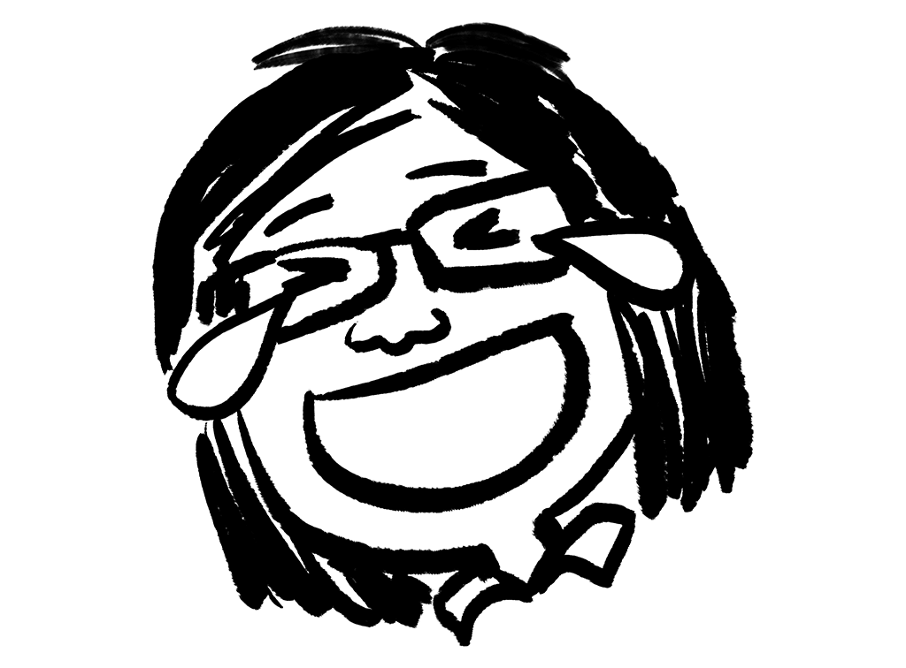
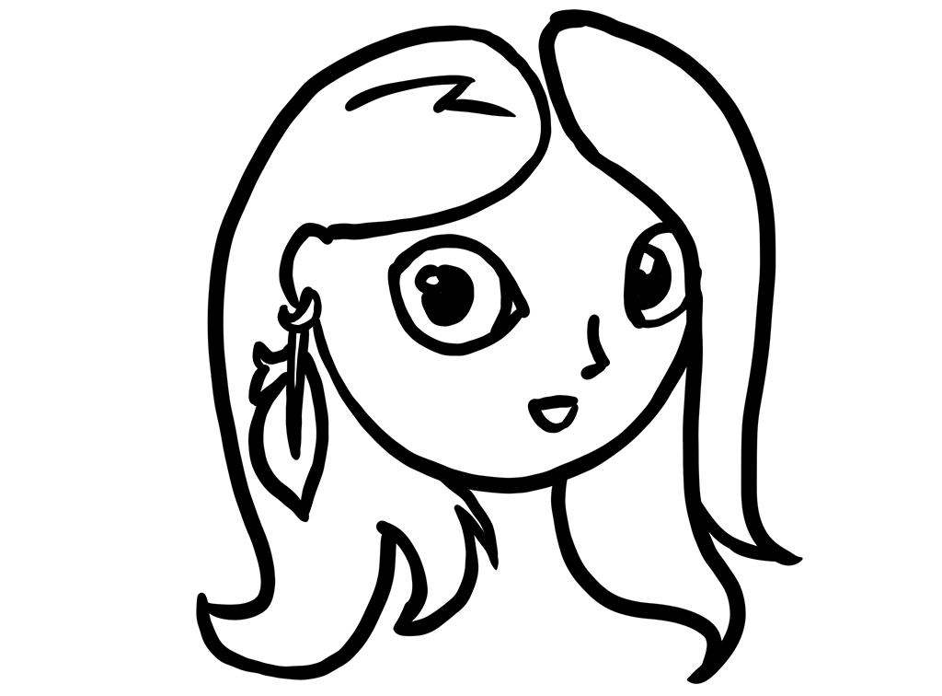
Hello from the Context Creative Accessibility Taskforce!
Mary Huang (she, her)
Account Supervisor
Accessibility Taskforce founder
Account team and client perspective
Christine “Steen” Hogenkamp (she, her)
Front-end Developer
Accessibility Taskforce lead
Developer perspective
Notes:
Hello from the Context Creative Accessibility Taskforce! We’re your presenters today.
My name is Mary Huang and I’m an Account Supervisor at Context Creative, and one of the founders of the Taskforce.
On the taskforce, I provide an account team and client perspective.
And this is my colleague, Steen, who will introduce herself. [handoff]
Steen: My name is Christine Hogenkamp, also known as Steen. I’m a Front-end Developer at Context, and the Accessibility Taskforce lead. I provide a developer perspective.

Slide 3
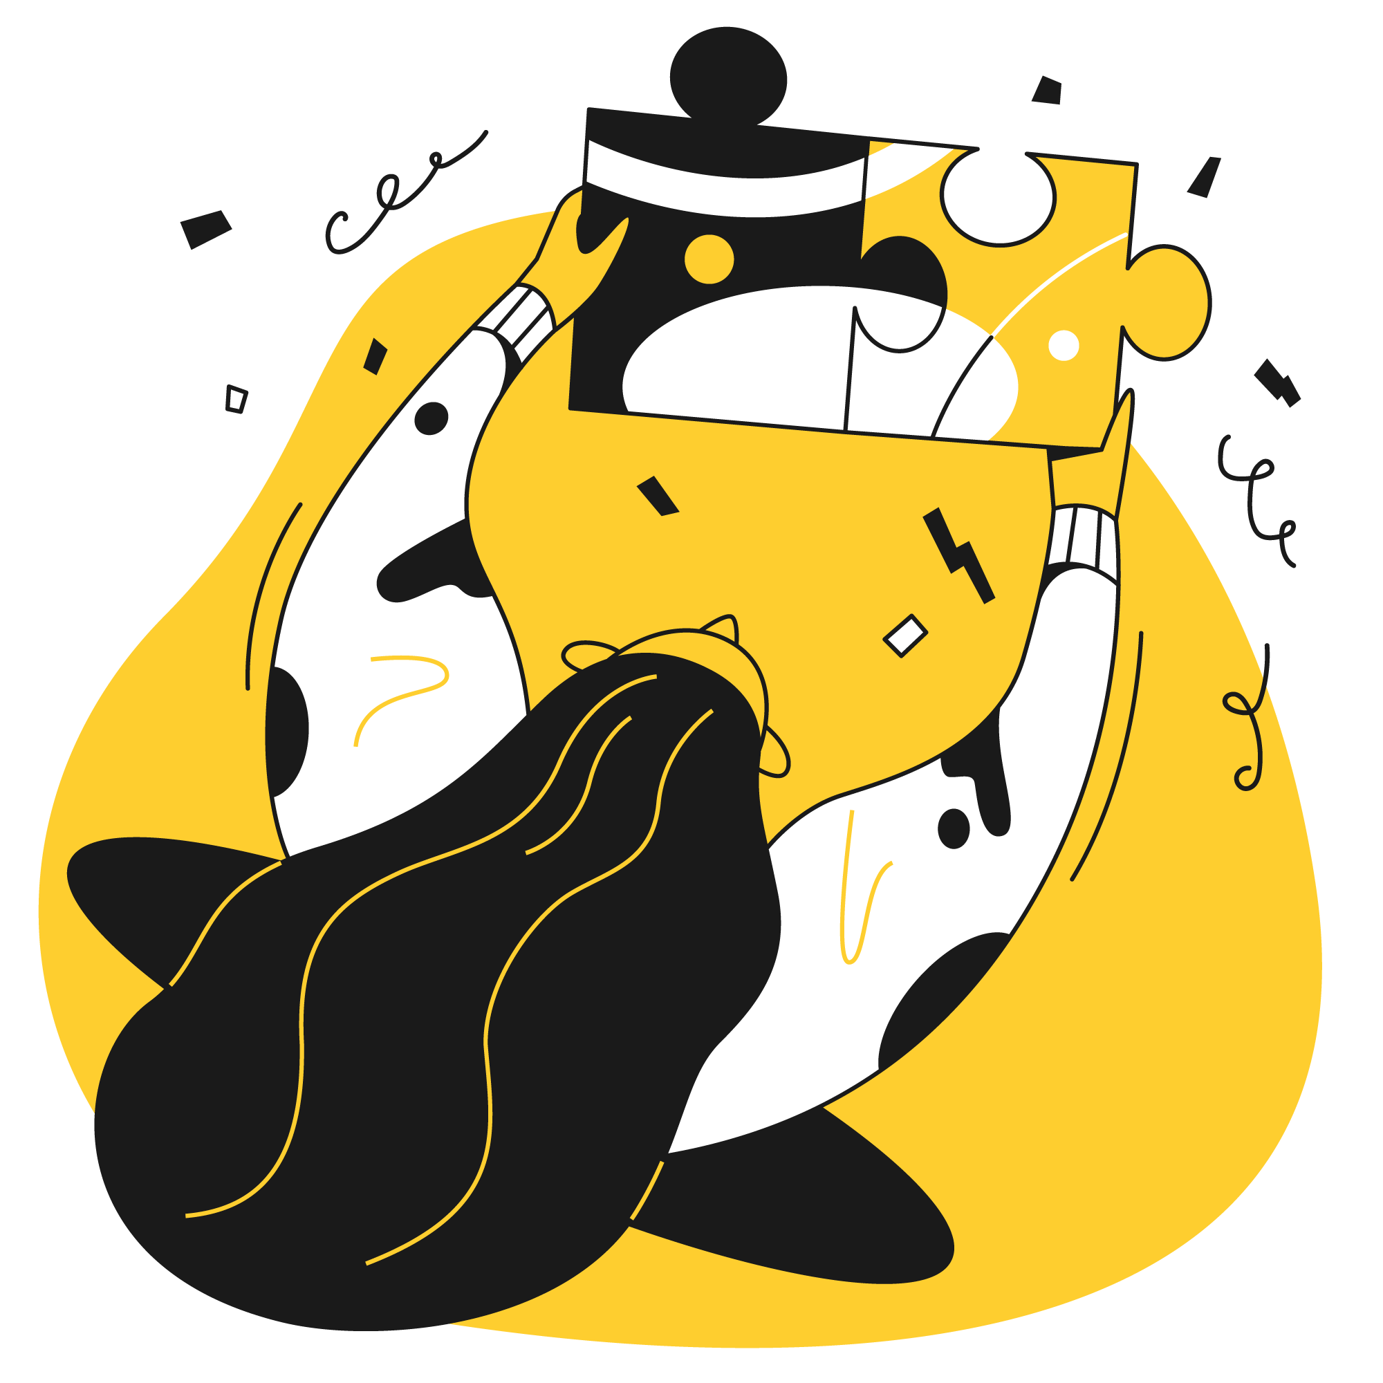
Context Creative:
A brief introduction
Notes:
To give you some context on Context and help you understand our perspective:
Context Creative is a medium-sized creative studio. What this means is that every day we juggle internal and external accessibility-related situations.
This includes staff training and support, client education, and crafting accessible communication experiences.

Slide 4
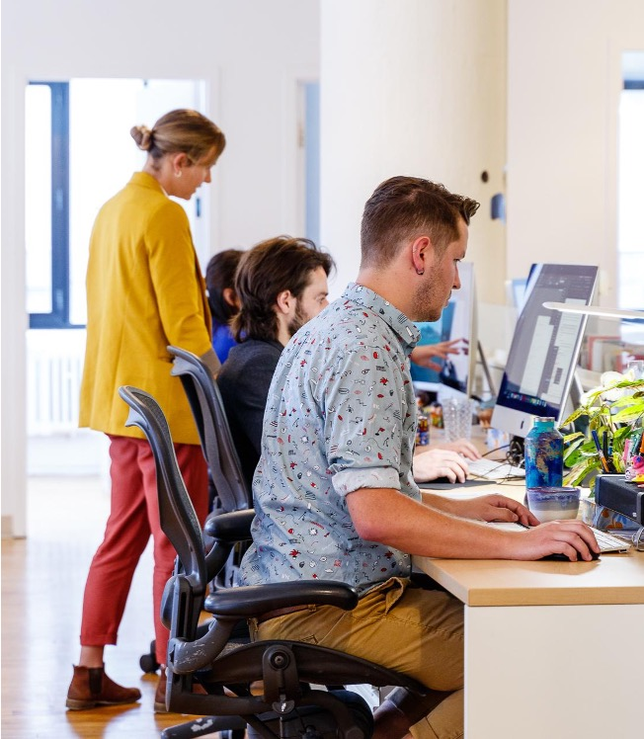
Quick facts
Award-winning Toronto-based creative agency established in 2001
Two active Principals, 32 full-time staff
Full service from strategy to execution
Notes:
Some quick facts about us:
Award-winning Toronto-based creative agency established in 2001
Currently two active Principals, 32 full-time staff
Offer full service from strategy to execution. We do print and digital campaigns, brand and content strategy, stakeholder engagement and user research, UX/UI, and more.

Slide 5
Quick facts (2)
Specialize in design and communications in regulated sectors
Projects recognized as accessibility best practice case studies
Regularly consult on accessibility best practices
Notes:
Specialize in purposeful design and communications for clients in regulated sectors: e.g., energy/environmental, healthcare, finance. We also work with cultural organizations and not-for-profits.
Projects recognized by organizations such as the Association of Registered Graphic Designers (RGD) as accessibility best practice case studies: e.g., government reports, educational microsites
Regularly consult for many of our clients on accessibility best practices

Slide 6
What is the Accessibility Taskforce?
Team representing our studio disciplines
Account/project management and client perspective
Print and digital design and development, motion graphics and animation
Digital marketing
Content and copywriting
Production and quality assurance, as well as general operations
Notes:
So what is this Accessibility Taskforce we keep talking about?
We’re a multidisciplinary team. The core group is about 8-10 volunteer staff, but the number of active participants at any time varies depending on staff availability and what’s happening in the studio.
Our team represents all major disciplines covered by Context Creative, including: [read slide points]

Slide 7
What is the Accessibility Taskforce? (2)
Mandate:
Ongoing learning
Documentation
Sharing and application of insights to help support and improve accessibility in all areas of the company
Notes:
This taskforce focuses on continuous learning, sharing and implementation of best practices to make things more accessible.
As a team, we collaboratively distribute responsibilities and create shared accountability.
When I started at Context about 10 years ago, this Taskforce did not exist.
This presentation summarizes our experiences and insights over the past 5+ years through overviews of how Context:
Addressed accessibility considerations prior to the Taskforce.
Saw the need for something like this Taskforce, and pitched the Taskforce idea to company owners/Principals.
Evolved the Taskforce as staff changed and the studio doubled in size.
Operate the Taskforce today.
By sharing our story, our trials and errors and learnings and successes, we hope to help other organizations who may also have limited resources establish their own sustainable approaches to accessibility.

Slide 8





Our culture
We deliver excellence
We are creative and agile
We uplift and respect others
We are
true partners
We never
stop learning
Notes:
I want to share a little bit about our culture, because the development of the Taskforce embodies all of these things. And for any organization it’s really important to reflect on what your culture is like to figure out what might work best for you.
A few years back as we were growing, we took some time to pause and reflect on what makes us tick - what we care about, what our philosophy is - so that we could continue to keep them in mind as we grew.
We determined these were our core values. [read slide points]
There’s more detail to each value, which is on our website, but that’s it in a nutshell.
You’ll see a lot of these themes come through as we talk about what we went through.

Slide 9
Our attitude to accessibility
Accessibility affects everyone
Every project is an accessibility project
You’re never done learning about accessibility
And in practice: Accessibility is not a “one-size-fits-all” checklist.
Notes:
As a creative studio, we’re not accessibility specialists. We’re not a company focused on remediating PDFs, for example, or auditing companies for compliance.
But we still have an important role to play.
I’m probably speaking to many of the converted already.
You’re probably here because you believe accessibility is everyone’s business, and you want to contribute to a positive and more inclusive world.
The principles we focus on are, which many of you likely share:
[read slide points]
As our values on the previous slide indicate, our team culture is very inquisitive - we want to really dig in deep, not just follow instructions without understanding why. Technology is a tool that can be used to help support accessibility, but it’s not the same as accessibility – and technology is always changing, we’re always learning. The better we understand accessibility principles and best practices, the more effective we can be in problem-solving and helping to create effective solutions from the ground up.
For example, if there’s a communication piece being created, sometimes people might default to resolving accessibility needs as “OK there will be an accessible PDF of the piece.”
But maybe accessible PDF isn’t the best solution for the project and the audience’s needs.
Practically speaking, understanding the principles helps us do our job better, and provide value to our clients too.

Slide 10
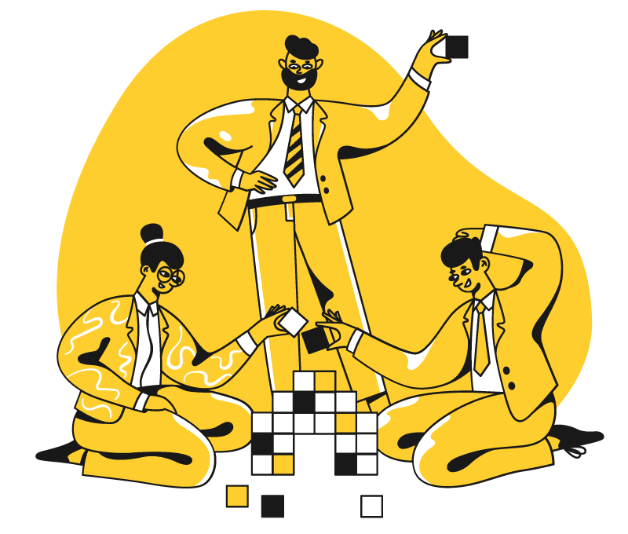
What was “accessibility” like at Context before the taskforce?
Notes:
Turning the clock back – what was accessibility like at Context before the taskforce? How did we deal with questions as they came up?

Slide 11
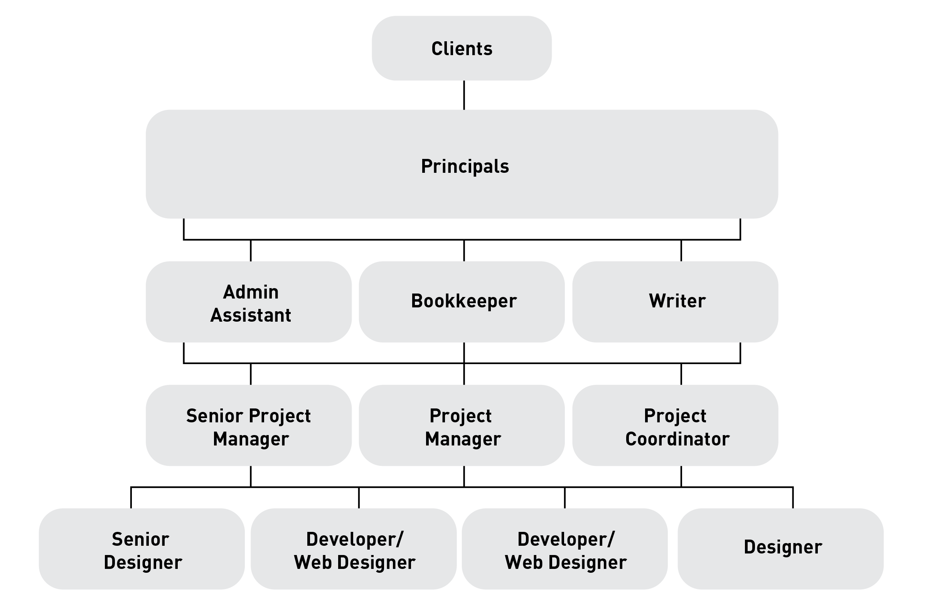
What did Context Creative look like?
Notes:
About five plus years ago, we were a small to medium-sized studio, approximately ~14-20 staff.
This is an approximation of what our team composition was like back then: 2-3 company principals, Admin Assistant, Bookkeeper, three project managers, and the studio was 1 writer and a mix of 1-2 developers, 3-4 designers.
Overall as a studio we had a decent grasp of accessibility.
We were not newbies - we had already worked with RGD and Government of Ontario, various Ministries and healthcare clients to develop materials and resources: print, digital, even conferences.
However…

Slide 12
Our approach to accessibility had gaps
Siloed information
No specific policy on research, documentation, implementation across projects
Unofficial “go-to” staff - resourcing issues and bottlenecks
Limited ability to build effectively on past insights
Reactive, not proactive
Notes:
There were gaps in our approach. I’ll summarize these high level, and depending on your situation and organization some of them might sound familiar.
Information on practical application was very siloed - project-to-project basis, learnings with individual staff on those projects
No specific policy on staying on top of accessibility and consistent implementation across all projects.
People gained knowledge by having to solve problems as they come up, but these solutions were in people’s heads. If someone got sick or went on vacation, or even if someone wasn’t working on a project or issue and wasn’t aware of it, we didn’t have easy access to that anymore.
Some staff became unofficial go-to’s, but it was hard to do their own job and deal with accessibility questions for other projects they weren’t technically working on. Even training someone else takes time, and if that person got busy or went on vacation, we were in the same situation again.
We didn’t always actually know *how* we solved a problem - e.g., when troubleshooting accessible PDFs - lots of Googling and poking at things. Lack of predictability was challenging not only for managing our own time but being able to provide value to our clients.
Beyond inability to consistently remember/build on our knowledge effectively, we were not actively looking out for new information/tools etc. - reactive instead of proactive
It was an ongoing challenge, and we knew this wasn't sustainable. At the same time, due to studio size, it did not make sense to have one person dedicated to nothing but accessibility.
I discussed with some of the staff who were most often involved in accessible work and research - the people who had become the go-tos, and we came up with an idea.

Slide 13

Envisioning a taskforce: the pitch
Notes:
Envisioning a taskforce: the pitch. Sounds fancy, but basically I wrote a long email to our Principals outlining some of the challenges I summarized on the previous slides, and proposed an idea for a solution.
Because of our company culture, I was pretty sure we had a compelling case, and there would be interest and support. Depending on your organization, you might need more detail in your proposals – perhaps a more formal cost-benefit analysis, looking at time and resourcing.
At the same time, I also wanted to make sure I proposed something that wouldn’t completely derail the rest of our operations. We didn’t have a huge number of staff and resources, and everyone was juggling a lot.
So there was a lot of recognition that this would be a starting point to finding a better way, with a commitment to try - and to try new things, to be open to change over time.

Slide 14
What could a team-based approach look like?
Taskforce with a mandate
Committed and supported
Figure out accessibility issues together
Entire studio expected to understand the taskforce’s findings and recommendations
Notes:
We started with what seemed obvious. We didn’t feel an individual-based approach was sustainable, so let’s have a team-based approach. What could this look like?
A taskforce with a mandate - a team of people who are committed and supported to stay on top of things in this area on a regular basis
A more balanced solution that helps to spread the workload as well.
A team that would figure out accessibility issues together, do research and troubleshoot, and then document and disseminate that to the rest of the studio, help make sure there’s clear and consistent understanding/implementation, not having things fall through the cracks
Everyone in the studio expected to understand the findings/recommendations of the taskforce

Slide 15
What could a team-based approach look like? (2)
Starting team: 2 Project Managers, 2 Developers/Web Designers, 2 Print Designers.
First step: Compile existing info, figure out gaps
Ongoing: Involve at least 2 Taskforce members on any issues
Regular meetings: 1-2x a month, disseminate info to studio periodically
Notes:
Starting team: 2 project managers, 2 developers, and 2 print designers (for continuity of knowledge if anyone is away, and sharing workload) - cover all specialty areas covered (print, web, speaking to and educating clients/scoping projects) - pulled from studio volunteers who expressed interest
First step: collect and review all the documentation, info, resources that we do have right now (from emails, client policies, things we had on our wiki, etc.) and then figure out how to organize it, and identify gaps of our own knowledge and process, and distributing that work to fill in those gaps
Ongoing basis, at least 2 people on the team should be involved in any accessibility questions we run into.
Taskforce meet regularly for updates (once or twice a month) to share things we've encountered or things we've learned and make sure it gets documented.
When there's a big enough accumulation of new knowledge, we could do a larger studio lunch and learn, and have information and research to be able to make clear recommendations on our processes.
One thing you may immediately notice - nothing wild or mind-blowing
A lot of this is already done adhoc, but not properly documented or shared - no established process or expectations, no centralizing, redundancy or continuity in case something happened.
This was a formalizing of things we were already doing bits and pieces of, and connecting the dots.

Slide 16
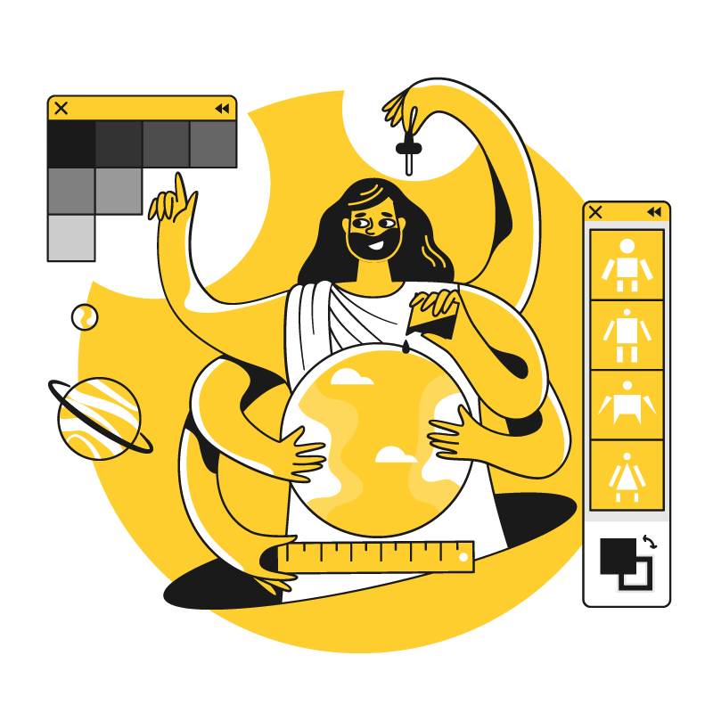
What worked, what didn’t
Notes:
Of course there is always a difference between expectation and reality. We learned as we went, and here are some things we learned.

Slide 17
Challenges
Scheduling taskforce meetings
Long unproductive sessions
Team members not being kept in the loop on issues or learnings
Missing perspectives
Overloaded coordinator
Notes:
Challenges we ran into:
It was hard to find time for everyone to meet during busy periods - everything had to be done in between paid client work and other responsibilities
Meetings would turn into really long sessions where some people were talking and others just sitting around because it was a technical discussion not of their expertise
Trying to remind people to loop in the Taskforce and not continuing to ask only the 1-2 people who had become known for troubleshooting accessibility. But at least they now knew they had a team behind them they could update and bring into the conversation, and feel less overwhelmed.
Trying to loop updates into the studio in a timely fashion - sometime there were lots of things happening and it also didn’t make sense to do a big lunch and learn
Some disciplines were not represented (e.g., we had no writer on the original taskforce, as our writing staff was much smaller)
Client-facing senior team member (Mary) who established the Taskforce was getting buried under other work both in terms of short term day to day and long term operations initiatives. The busier we got, the more client communications we had to manage - and having a hard time coordinating and keeping track of everything going on, especially the very technical nitty-gritty details

Slide 18
Challenges - Solutions
Scheduling taskforce meetings
Change: Make involvement more flexible - use of team representatives
Long unproductive sessions
Change: Monthly regroups focused on high level run through of to-dos; separate meetings scheduled by team members involved as needed
Notes:
Changes we made:
We experimented with different levels of involvement from the whole organization: instead trying to schedule meetings for everyone to be available, we tried inviting everyone who wanted to attend, but at minimum one person from every discipline had to be present or have a rep who would take info/updates to them.
Attendees were responsible for helping to make their studio team aware of updates (e.g., AM rep would update AMs, developer rep update developers, etc.)
Monthly meeting changed to focus on high-level run through of to-dos, e.g., is the task active or are you done, do you need help
Further discussion would be a separate meeting to be set up with the people involved instead of taking up the rest of the time - we’re getting more and more efficient! Sometimes we still do get into the weeds during a meeting but much better than before

Slide 19
Challenges - Solutions (2)
Team members not being kept in the loop on issues or learnings
Change: Project management and collaboration tools to help manage and share progress and information.
Missing perspectives
Change: As the studio grew, we added more disciplines - writing, animation, digital marketing, etc.
Notes:
Use of more project management and collaboration tools to manage and share progress and information. We tried a lot of them! This actually helped a lot too when the pandemic started a few years later!
As we grew, we added more specialist disciplines to the team - writing, animation, etc.

Slide 20
Challenges - Solutions (3)
Overloaded coordinator
Non-client facing team member volunteered to take the lead!
Notes:
A non-client facing team member volunteered to take on the lead coordinating role - Steen!
And this is a perfect place for me to hand it over to Steen to take us through where we are today.

Slide 21

Where we are today
Notes:
The Context taskforce: where we are today

Slide 22
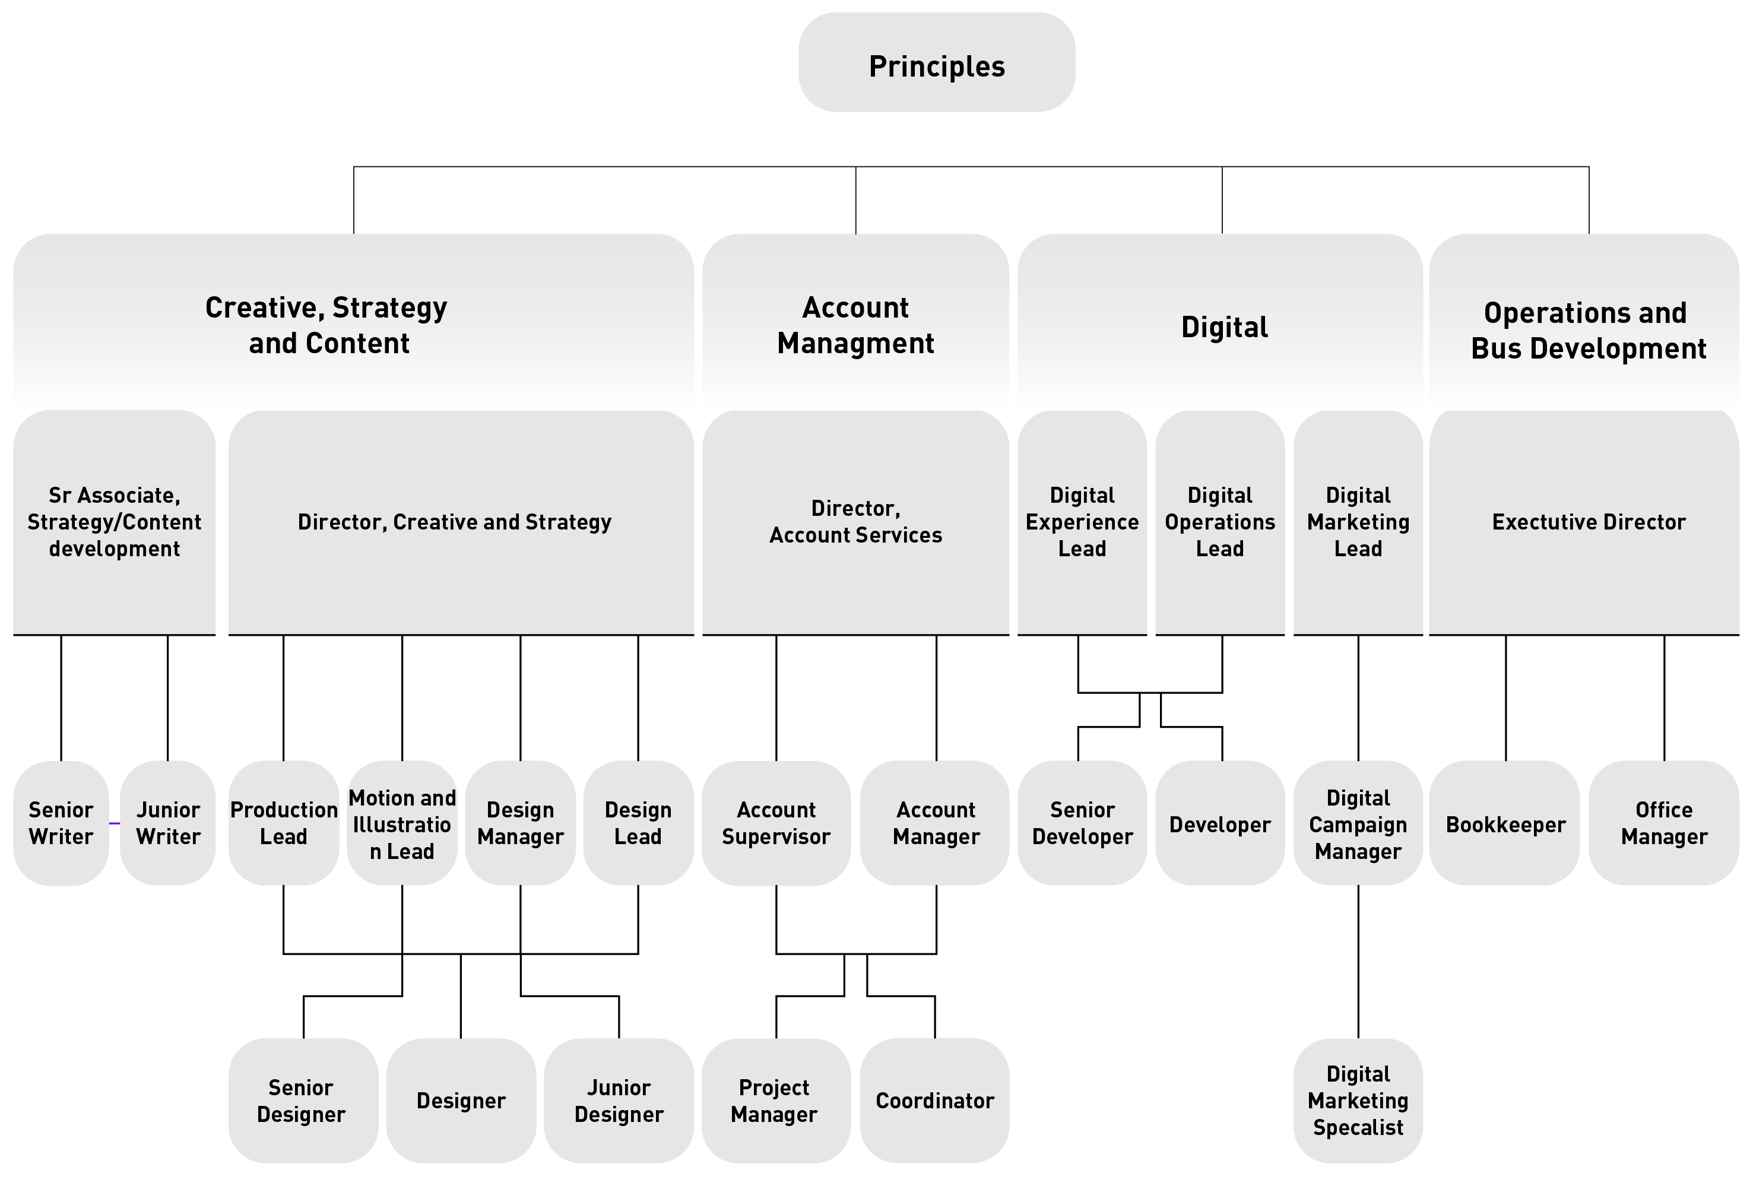
We’ve grown!
32 staff
Taskforce meetings include reps from 6 largest disciplines, plus a flexible number of participants
Notes:
We’ve grown and expanded!
We are now a staff of 32 people, and our Task Force includes representatives from the six largest disciplines, plus a flexible number of participants: this includes Designers, Animators, Developers, Account Managers, Copywriters, and the Digital Marketing team. And on this slide is a chart of the more complex system we currently use to organize each sector.
As well, we often have regular office staff volunteer to attend the meetings of their own interest. Proactive participation is always encouraged!

Slide 23

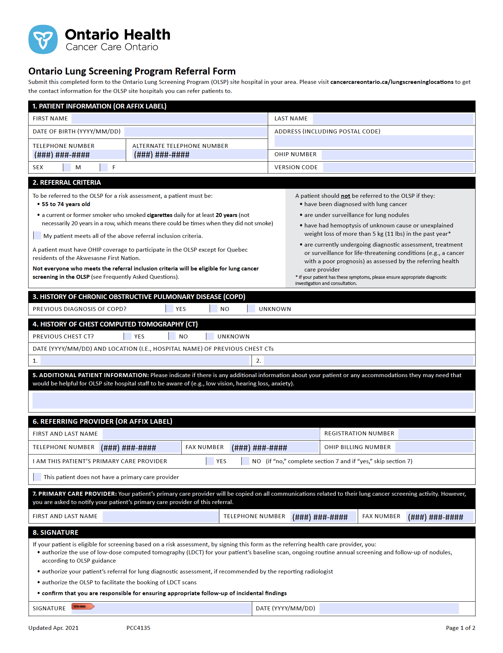
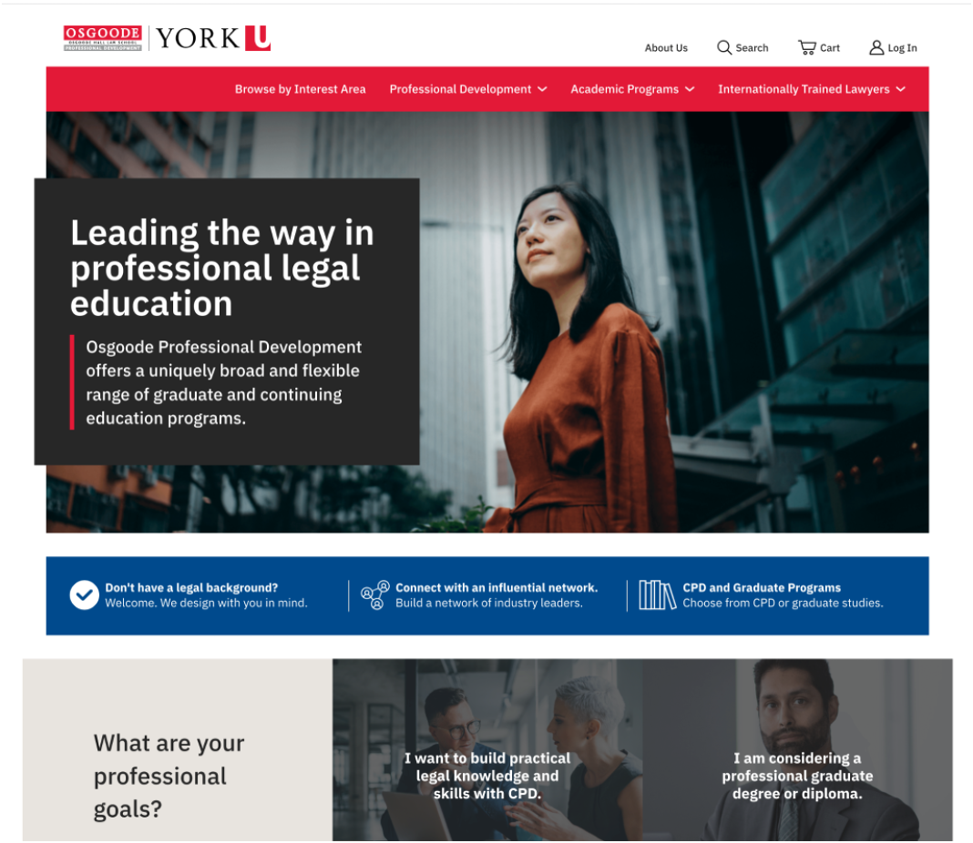
We’ve been able to apply insights to:
PDFs including fillable forms
In-house templates as part of our workflow
Website development & accessibility audits
Videos & animations
Other marketing applications
Notes:
And our clients & projects have grown along with us:
As Mary mentioned, we work with many clients including government and public sector organizations
We provide consulting on best practices for various types of media: using info from our existing knowledge base, and we also consult with industry leaders and actively monitor what is happening in accessibility spaces around the world.
We've been able to apply our insights to:
PDFs including fillable forms
Where we provide relevant insights for the design of various documents, as well as improved technical specs
In-house templates as part of our workflow
Website development & accessibility audits
We use both automated checkers and manual audits, We also build websites using our own developer library of accessible components
Accessible Videos & Animations
Making sure they include special considerations such as closed captions
And other marketing applications: Where we advise on best practices for social media and client brand palettes
And when appropriate, we partner with specialists to ensure we follow best practices and help make expert knowledge accessible to our clients.

Slide 24
A new lead arises – Steen!
Volunteered on the basis of:
Less client-facing workload and more flexibility of “free time”
Interest in accessibility and improving project workflow
Notes:
And a new lead has arisen in the taskforce - me! As the workload of original coordinator (Mary) grew, a new taskforce coordinator volunteered on the basis of:
Less client-facing workload and more flexibility of “free time”
I’m a developer who does relatively few client meetings or other client-facing work, and my work tends to be “shorter” development projects (days vs weeks/months) which gives me more flexibility to coordinate tasks such as reviewing task updates, contributing to various discussions and answering questions
I have an active interest in accessibility and improving project workflow, as well as creating clear how-to docs for better project efficiency

Slide 25
A new lead arises – Steen! (2)
Also, the duties of the taskforce lead expanded:
Acting as coordinator for requests for help from taskforce
Keeping tabs on various accessibility best practices
Actively encouraging and advocating for accessibility mindfulness
Notes:
Also, the duties of the taskforce lead expanded to include:
Acting as coordinator for requests for help from taskforce, from anyone at Context
Keeping tabs on various accessibility best practices - such as, are we up to date on our how-to docs, have we learned anything new to improve the end results?
And also, actively encouraging and advocating for accessibility mindfulness in our day-to-day work and office interactions.

Slide 26
Taskforce as accessibility hub - benefits
Everyone is empowered to act as an “accessibility officer”
Access to taskforce meetings creates opportunities to improve understanding:
  Staff can attend meetings directly or pass on requests
  Complex problems or client inquiries can be reviewed and researched by multiple people
Notes:
The Taskforce today acts as an accessibility hub: a centralized knowledge base of made up of volunteers and written resources
Benefits of this hub include:
Everyone is empowered to act as an “accessibility officer” through training and access to documentation
The mental load of “knowing accessibility” is more evenly distributed and more readily accessible
Access to taskforce meetings for all staff creates opportunities to improve understanding:
Staff can attend meetings directly or pass on their requests through one of our reps to ask for help
Complex problems or client inquiries can be reviewed and researched by multiple people
Everyone feels supported in having a team to help doublecheck assumptions or help research answers
That gives us the ability to address client questions with the help of our Taskforce, who will assess and provide necessary information or explanations, and be confident that we will have a multi-faceted, well thought out, well researched response

Slide 27
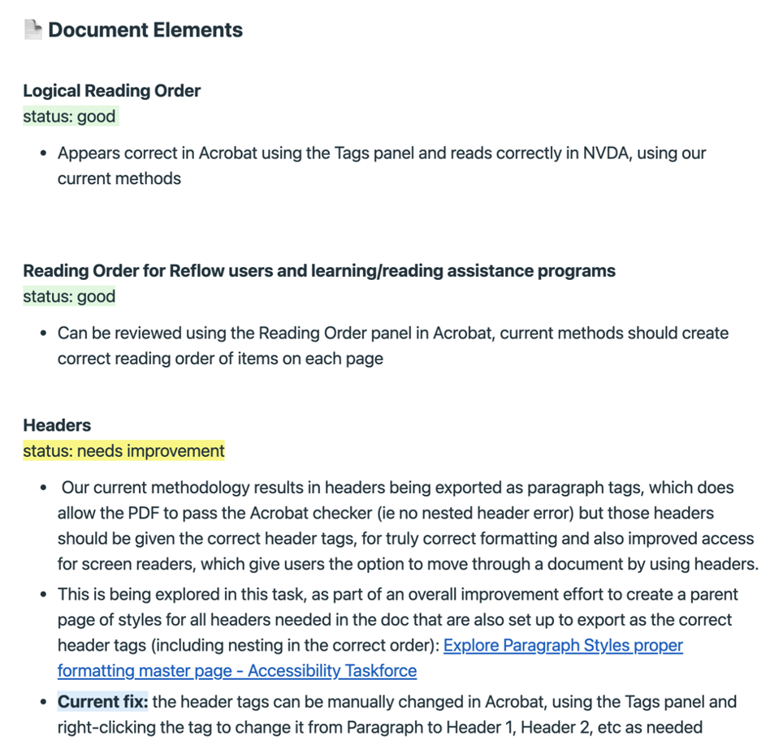
Taskforce as accessibility hub - benefits (2)
Ability to track long-term progress for troubleshooting technical issues or updating existing documentation
Notes:
We also have the ability to track long-term progress for troubleshooting technical issues or updating existing documentation
This includes more complex projects that require research and testing, or improving on existing methodologies as new information is discovered
As an example, this slide includes a screenshot of a post from our Basecamp Taskforce messageboard, where I had created a summary of our current knowledge for creating accessible PDFs and the status of each type of document element, as quick reference to which elements were formatted correctly and which elements needed more research or testing to further refine the results.

Slide 28
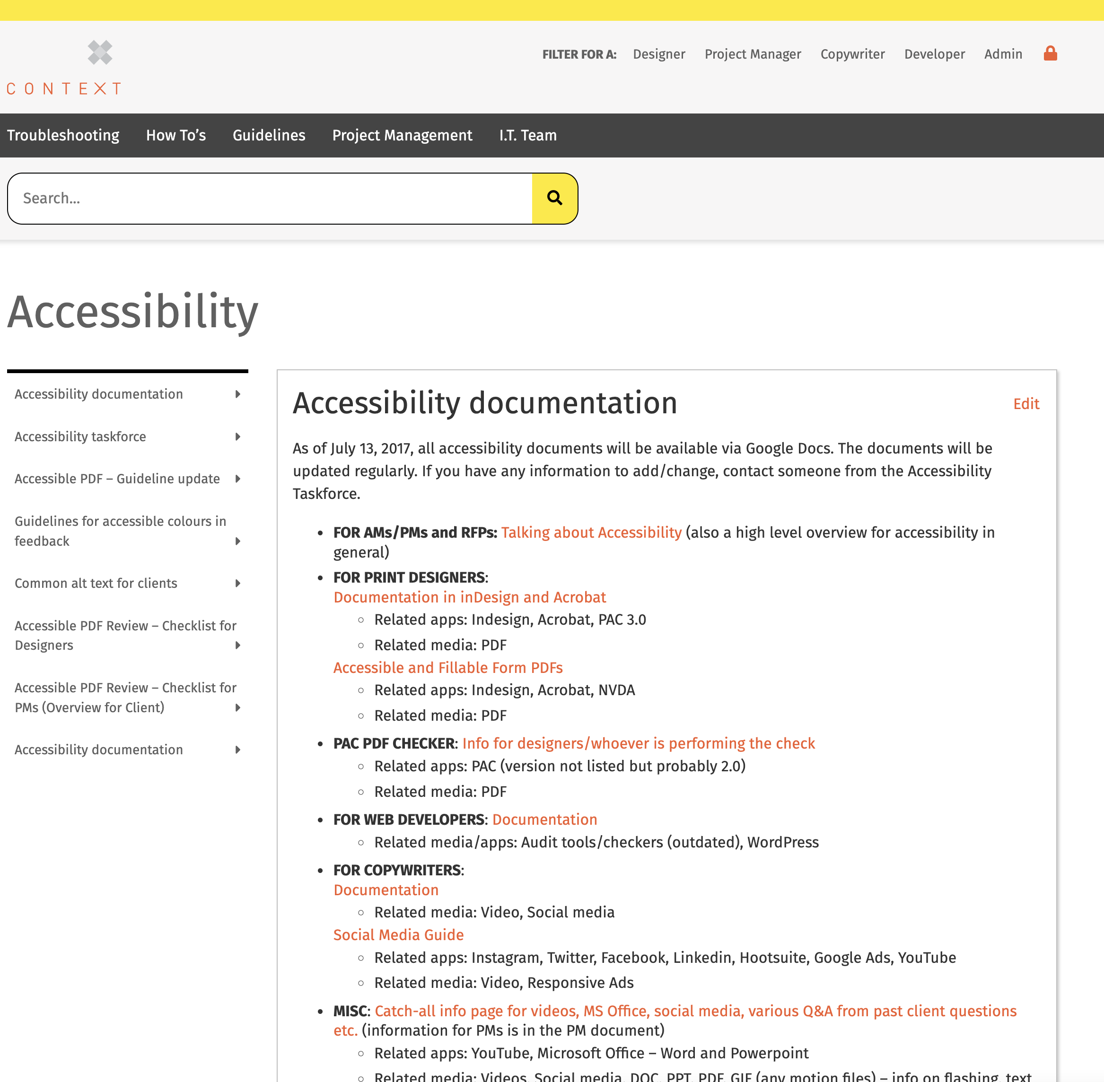
Tools we use
Organizing tasks, training and documentation:
Google Docs
Airtable – airtable.com
Basecamp – basecamp.com
Infohub - intranet and central hub for documentation
Notes:
In the past, our taskforce started out using email plus an internal wiki that acted as an intranet, and also Google docs, as tools that helped us document our accessibility efforts:
They were low cost, easy to collaborate with
Today, the tools we use have expanded to include:
For organizing our tasks, training and documentation, there is:
Google docs and Airtable, which we use for tracking complex data and resources
Basecamp, to coordinate the taskforce team and ongoing to-do tasks, Basecamp also serves as repository for relevant helpful links organized by topic (ie., for designers, for developers, for copywriters, etc) or for tracking conversations on more broad or complex topics, to give everyone an opportunity to contribute.
Infohub: what started out as an internal wiki using free software became a customized Wordpress site as a central hub for finding various documentation links. This internal hub also contains info about our own accessibility best practices, for training and reference purposes.
Wordpress is a CMS (Content Management System), and using a CMS which has a more user-friendly interface allows more staff to help keep Infohub site up-to-date, no code required

Slide 29
Tools we use (2)
Assistive Technology for testing purposes:
Screen readers: NVDA, VoiceOver
Audit software and online resources: PAC3, Lighthouse, Achecker, WebAIM Color Contrast Checker, Coblis Colour Blindness Checker, WebFX Readability Test Tool
Start with low-cost or free tools and when paid tools are necessary, explore what options are within your budget
Notes:
We use Assistive Technology for testing purposes: These are a modest selection of assistive tech that are within our budget, which allows us to improve our testing of various digital media. The effort to better incorporate these technologies is ongoing and evolving over time.
Screen readers: NVDA, VoiceOver
Audit software and online resources: PAC3, Lighthouse, Achecker, WebAIM Color Contrast Checker, Coblis Colour Blindness Checker, WebFX Readability Test Tool
Start with low-cost or free tools and when paid tools are necessary, explore what options are within your budget

Slide 30
Tools we use (3)
News resources
Online newsletters to stay current in accessibility news and tech:
WebAIM Web Accessibility E-mail Discussion List – webaim.org/discussion
A11y Weekly – a11yweekly.com
AODA Toolbox Newsletter – aoda.ca/newsletter
Notes:
And we use News resources: I signed up for various accessibility newsletters to stay current in accessibility news and tech, to share with others at Context, such as:
- WebAIM Web Accessibility E-mail Discussion List
webaim.org/discussion/
- A11y Weekly
a11yweekly.com/
- AODA Toolbox Newsletter
aoda.ca/newsletter/
I like to share articles that have perspectives of people with disabilities, opinions of experts in the accessibility community, and legal updates especially for Ontario/Canada

Slide 31
Where we started vs. now
Accessibility knowledge limited to a few individuals on a per-case basis
New learnings not always captured, hard to find past info
Basic audits using only automated checkers, some errors were not discovered
Leadership limited to one person who became overwhelmed by other commitments
Limited accessibility considerations and understandings
Notes:
So looking back at:
How we started, as Mary mentioned:
Accessibility expertise was limited to a few individuals on a per-case basis, with some documentation for repeat projects like accessible PDFs
New learnings were not always captured after the project had ended, and it was hard to find past info without having to dig through email chains
Basic audits were done using only automated checkers, some errors were not discovered
When the taskforce was created, leadership was limited to one person who became overwhelmed by other commitments
Accessibility considerations and understandings were limited

Slide 32
Where we started vs. now (2)
Accessibility knowledge limited to a few individuals on a per-case basis
Now: Accessibility is part of onboarding for all new hires & all staff are given training as needed
New learnings were not always captured, hard to find past info
Now: Accessibility info/tutorials are clearly documented for reference by anyone for any project
Notes:
And compared to how we are now:
Accessibility is part of onboarding for all new hires & all staff are given training. Accessibility expertise is something anyone can have and should have, and there are ongoing efforts to improve our best practices.
Accessibility info and tutorials are clearly documented for reference by anyone for any project: how-to docs and other relevant information such as resource links and tutorials elsewhere on the Internet are organized through our Infohub and taskforce group on Basecamp

Slide 33
Where we started vs. now (3)
Basic audits using only automated checkers, some errors were not discovered
Now: Audit process starts with automated checkers but uses other tools including assistive tech, with improved error-fixing
Leadership was limited to one person who became overwhelmed by other commitments
Now: Taskforce now lead by person with fewer client-facing responsibilities and taskforce reps help share the load
Notes:
Our Audit process starts with automated checkers but uses other tools including assistive tech, with improved error-fixing: Our accessible audit process has been refined: we took our existing audit process and found ways to add manual audits to check for things such as correct logical reading order, correct tag usage, and other elements. We often use the screen reader NVDA in our testing and we are exploring other assistive tech options
Taskforce now led by person with fewer client-facing responsibilities and taskforce reps help share the load

Slide 34
Where we started vs. now (4)
Accessibility considerations and understandings were limited
Now: Accessibility is more robust, multi-faceted and better incorporated throughout our processes
Notes:
Overall, our Accessibility is more robust, multi-faceted and better incorporated throughout our processes

Slide 35
Start small, adjust as needed
“Don’t let the perfect become the enemy of the good”
Recognize existing resources within your organization
  Start your own accessibility hub
  Start documenting important processes
Notes:
So our advice to other organizations: Start small, adjust as needed
“Don’t let the perfect become the enemy of the good” a fave saying of mine - start somewhere in a way that fits your organization, build from there, learn and improve, and adjust existing resources as needed
Adding accessibility to your organization is a process, can’t just be purchased as a ready-made, use-straight-out-the-box product
Recognize existing resources within your organization: use the tools available to you, but emphasize tools that allow for collaboration and easy use/access/editing for everyone involved
Start your own accessibility hub - a landing page or portal for links to docs, websites, other resources
Start documenting important processes: any technical processes or workflow that are specific to accessibility or a specific product or service, and make this documentation available to all

Slide 36
Start small, adjust as needed (2)
Look for relevant experts from the accessibility community
Explore options for adding accessibility tools
Notes:
Look for relevant experts from the accessibility community, to help get a better understanding of the big picture of accessibility - in Ontario, in the US, internationally, etc. Be aware of the “politics of the day” and how they affect your organization.
Be aware that guidelines and checklists from accessibility experts are a good starting point for establishing accessibility best practices, but you also need to educate everyone to a level that allows them to understand what these standards are trying to achieve.
Explore options for adding accessibility tools, depending on the types of projects your org works on or services they provide, such as:
Screen readers or other assistive technologies
Software for creating accessible PDFs
And testing software for accessible websites

Slide 37
Start small, adjust as needed (3)
Find motivated coworkers to lead and inspire
Create a culture of support for questions and learning
Consider how you will manage client/stakeholder expectations
You can do it!!
Notes:
Find motivated coworkers to lead and inspire: Not just lead the efforts for better workplace project practices but also to look for ways to inspire interest in accessibility for all departments or types of team member
Accessibility is a part of everyday life which includes the workplace, and for every type of job there is an opportunity to assess accessibility and make improvements.
Create a culture of support for questions and learning: for team members to actively think about accessibility and give opportunities for answering questions and providing clarification.
Consider how you will manage client or stakeholder expectations: review client-facing workflow to adjust timelines for new accessible aspects to projects, and ensure Account Managers are empowered by documentation to answer client questions and provide supporting information from official sources as needed.
You can do it!!

Slide 38
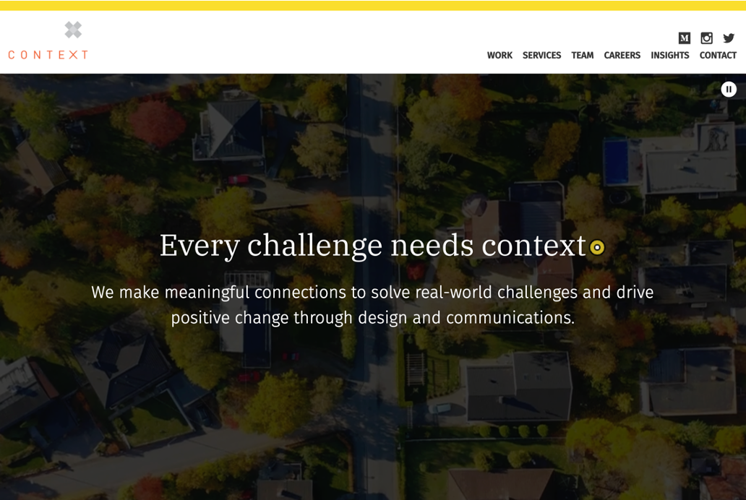
Thank you! Questions?
contextcreative.com
info@contextcreative.com
Notes:
Thank you for attending our presentation!
We’d be happy to answer any questions at this time, or please feel free to contact us afterwards either by visiting contextcreative dot com or emailing us at info at context creative dot com.

